Slide 1
Week 7 Sessions 8
10/10/2025

Slide 2

Recursion
Recursion: The definition of an operation in terms of itself.
Solving a problem using recursion depends on solving smaller occurrences of the same problem.
Recursive programming: Writing methods that call themselves to solve problems recursively.
An equally powerful substitute for iteration (loops)
Particularly well suited to solving certain types of problems

Slide 3
Why learn Recursion?
“Cultural experience” – A different way of thinking of problems.
Can solve some kinds of problems better iteration.
Leads to elegant, simplistic, short code (When used well).
Many programming languages (“functional languages such as Scheme, ML, and Haskell) use recursion exclusively (no loops).
A key component of the rest of the assignments in CPS181.
(Because we’ll be working with data structures)

Slide 4
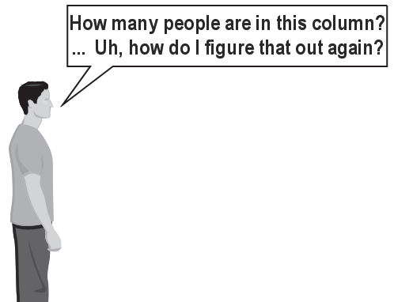

Exercise
(To a student In the front row)
How many students total are directly behind you in your “column” of the classroom?
You have poor vision, so you can only see the people right next to you. So you can’t just look back and count.
BUTTT you are allowed to ask questions of the person next to you.
How can we solve this problem?
(Recursively)

Slide 5
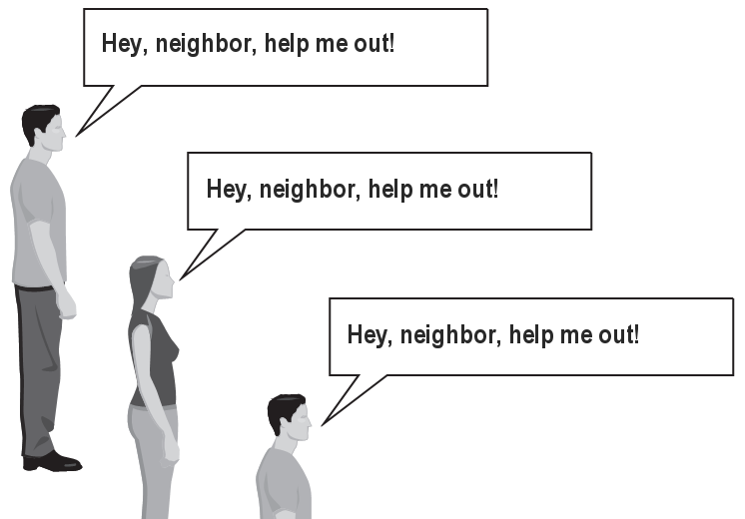
The idea
Recursion is all about breaking a big problem into smaller occurrences of that same problem.
Each person can solve a small part of the problem.
What is a small version of the problem that would be easy to answer?
What information from a neighbor might help me?

Slide 6
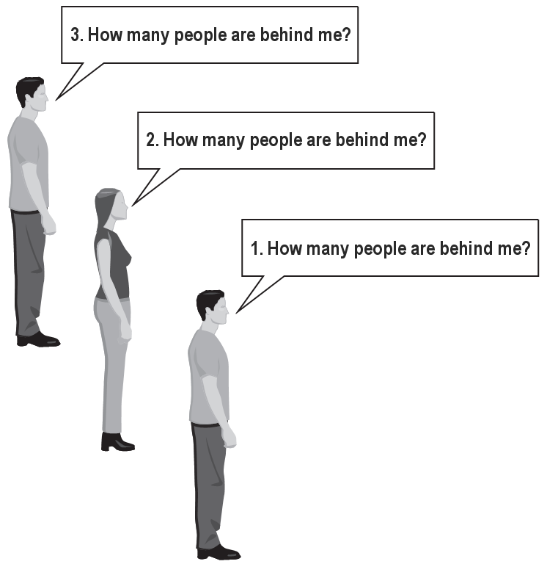
Recursive algorithm
Number of people behind me:
If there is someone behind me,
Ask him/her how many people are behind him/her.
When they respond with a value N, then I will answer N + 1.
If there is nobody behind me, I will answer 0.

Slide 7
Recursion and cases
Every recursive algorithm involves at least 2 cases:
Base case: A simple occurrence that can be answered directly.
Recursive case: A more complex occurrence of the problem that cannot be directly answered. But, can instead be described in terms of smaller occurrences of the same problem.
Some recursive algorithms have more than one base or recursive case, but all have at least one of each.
A crucial part of recursive programming is identifying these cases.

Slide 8
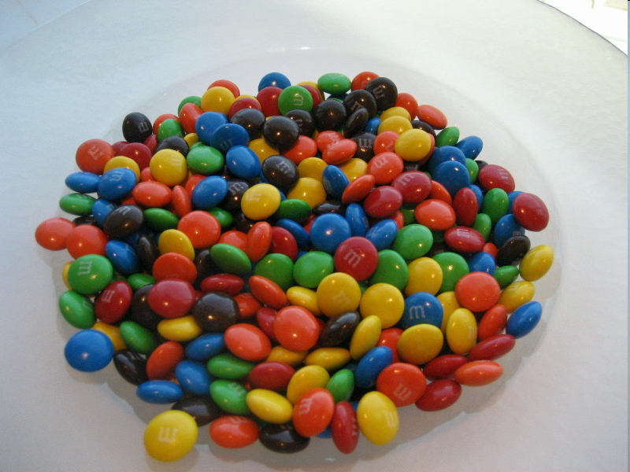
Another recursive task
How can we remove exactly half of the M&M’s in a large bowl, without dumping them all out or being able to count them?
What if multiple people help with solving the problem?
Can each person do a small part of the work?
What is a number of M&M’s that it is easy to double, even if you can’t count?
(What is a “base case”?)

Slide 9
Recursion in java
Consider the following method to print a line of * characters:
// Prints a line containing the given number of stars.
// Precondition: n >= 0
public static void printStars(int n) {
for (int i = 0; i < n; i++) {
System.out.print("*");
}
System.out.println(); // end the line of output
}
Write a recursive version of this method (that calls itself).
Solve the problem **WITHOUT USING ANY LOOPS**
Hint: Your solution should print just one star at a time.

Slide 10
A basic case
What are the cases to consider?
What is a very easy number of stars to print without a loop?
public static void printStars(int n) {
if (n == 1) {
// base case; just print one star
System.out.println("*");
} else {
...
}
}

Slide 11
Handling more cases
Handling additional cases, with no loops (in a bad way):
public static void printStars(int n) {
if (n == 1) {
// base case; just print one star
System.out.println("*");
} else if (n == 2) {
System.out.print("*");
System.out.println("*");
} else if (n == 3) {
System.out.print("*");
System.out.print("*");
System.out.println("*");
} else if (n == 4) {
System.out.print("*");
System.out.print("*");
System.out.print("*");
System.out.println("*");
} else ...
}

Slide 12
Using recursion properly
Condensing the recursive cases into a single case:
public static void printStars(int n) {
if (n == 1) {
// base case; just print one star
System.out.println("*");
} else {
// recursive case; print one more star
System.out.print("*");
printStars(n - 1);
}
}

Slide 13
Recursive tracing
Consider the following recursive method:
public static int mystery(int n) {
if (n < 10) {
return n;
} else {
int a = n / 10;
int b = n % 10;
return mystery(a + b);
}
}
What is the result of the following call?
Mystery(648)

Slide 14
A recursive trace
mystery(648):
int a = 648 / 10; // 64
int b = 648 % 10; // 8
return mystery(a + b); // mystery(72)
mystery(72):
int a = 72 / 10; // 7
int b = 72 % 10; // 2
return mystery(a + b); // mystery(9)
mystery(9):
return 9;

Slide 15
Recursive tracing 2
Consider the following recursive method:
public static int mystery(int n) {
if (n < 10) {
return (10 * n) + n;
} else {
int a = mystery(n / 10);
int b = mystery(n % 10);
return (100 * a) + b;
}
}
What is the result of the following call?
mystery(348)

Slide 16
A recursive trace 2
mystery(348)
int a = mystery(34);
int a = mystery(3);
return (10 * 3) + 3; // 33
int b = mystery(4);
return (10 * 4) + 4; // 44
return (100 * 33) + 44; // 3344
int b = mystery(8);
return (10 * 8) + 8; // 88
return (100 * 3344) + 88; // 334488
What is this method really doing?

